Slide 1
Machine Learnig

Slide 2
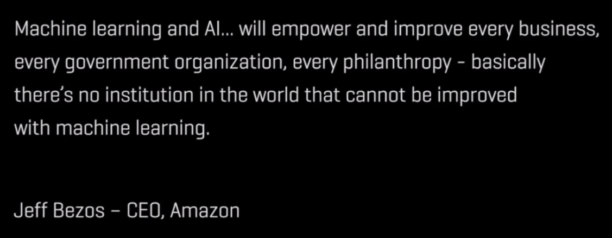

Slide 3
Artificial Intelligence [ AI ]
Artificial Intelligence ( AI ) refers to the simulation of human intelligence in machines that are programmed to think like humans and mimic their actions.
The ideal characteristic of artificial intelligence is its ability to rationalize and take actions that have the best chance of achieving a specific goal
e.g.
google assistant
alexa
siri
self driving cars

Slide 4
AI Applications
AI in Marketing
AI in Banking
AI in Finance
AI in Agriculture
AI in Healthcare
AI in Gaming
AI in Space Exploration
AI in Autonomous Vehicles
AI in ChatBoats
AI in Artificial Creativity

Slide 5
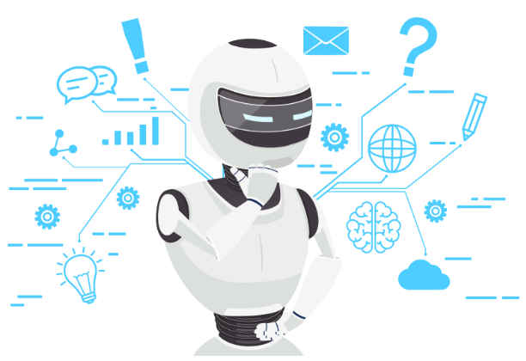
AI in Marketing
35% of Amazon’s revenue is generated by its recommendation engine. Amazon makes use of AI & ML to recommend products to their customers
75% of what you watch is recommended by Netflix.

Slide 6
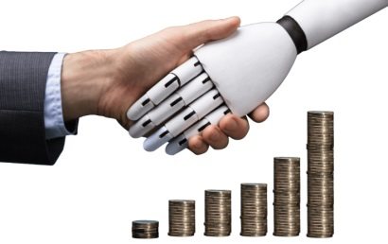

AI in Banking
AI in banking is growing faster than you thought! A lot of banks have already adopted AI-based systems to provide customer support, detect anomalies and credit card frauds. An example of this is HDFC Bank.
HDFC Bank has developed an AI-based chatbot called EVA (Electronic Virtual Assistant), built by Bengaluru-based Senseforth AI Research.
Since its launch, Eva has addressed over 3 million customer queries, interacted with over half a million unique users, and held over a million conversations. Eva can collect knowledge from thousands of sources and provide simple answers in less than 0.4 seconds.

Slide 7

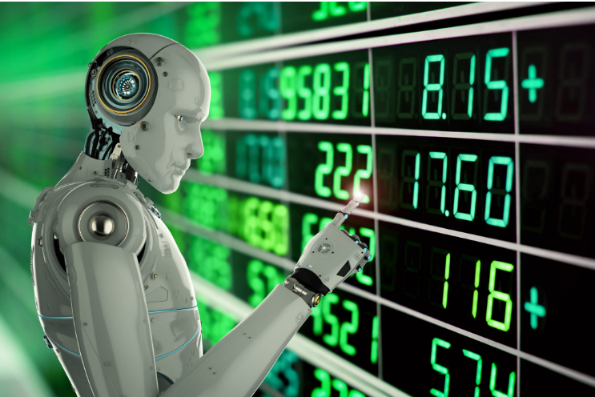
AI in Finance
Ventures have been relying on computers and data scientists to determine future patterns in the market. Trading mainly depends on the ability to predict the future accurately.
Machines are great at this because they can crunch a huge amount of data in a short span. Machines can also learn to observe patterns in past data and predict how these patterns might repeat in the future.
One such organization is Japan’s leading brokerage house, Nomura Securities

Slide 8

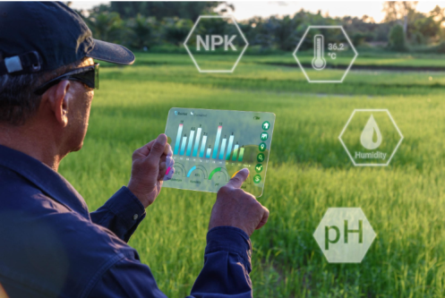

AI in Agriculture
Organizations are using automation and robotics to help farmers find more efficient ways to protect their crops from weeds.
Blue River Technology has developed a robot called See & Spray which uses computer vision technologies like object detection to monitor and precisely spray weedicide on cotton plants. Precision spraying can help prevent herbicide resistance.
Apart from this, Berlin-based agricultural tech start-up called PEAT, has developed an application called Plantix that identifies potential defects and nutrient deficiencies in the soil through images.

Slide 9

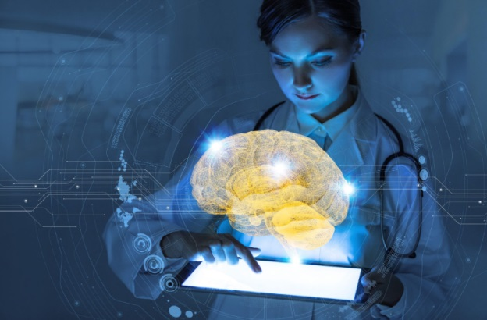

AI in Healthcare
Healthcare organizations use IBM AI ( Watson ) technology for medical diagnosis
DeepMind has successfully developed a system that can analyze retinal scans and spot symptoms of sight threating eye diseases

Slide 10


AI in Gaming
DeepMind’s AI-based AlphaGo software, which is known for defeating Lee Sedol, the world champion in the game of GO, is considered to be one of the most significant accomplishment in the field of AI.

Slide 11

AI in Space Exploration
Astronomers used AI to sift through years of data obtained by the Kepler telescope to identify a distant eight planet solar system
AEGIES is AI based rover is already on the red planet

Slide 12



AI in Autonomous Vehicles
WAYMO’s AI software crunches data from the vehicles radar , cameras , gps , cloud services to produce control signals that operate the driverless vehicle

Slide 13

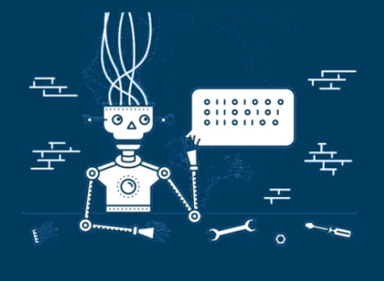

AI in Chat Boats
Amazon Echo is a device that uses speech recognition and NLP to perform an ever growing range of tasks on command

Slide 14
AI in Artificial Creativity
MuseNet a deep neural network that can generate 4 minute musical compositions with different instruments
Wordsmith is an AI powered tool that produces written analytics by transforming given data

Slide 15


AI in Social Networking
Twitter is using AI to identify hate speech and terroristic language in tweets
Facebook uses Machine Learning & Deep Learning to detect facial features and tag your friends

Slide 16
AI Predictions for 2020
53% of global data and analytics decision makers say they have implemented, are in the process of implementing, or are expanding or upgrading their implementation of some form of artificial intelligence.
25% of the Fortune 500 will add AI building blocks (e.g. text analytics and machine learning) to their Robotic Process Automation (RPA) efforts to create hundreds of new Intelligent process automation (IPA)
75% of enterprises will embed intelligent automation into technology and process development, using AI-based software to discover operational and experiential insights to guide innovation.

Slide 17
Machine Learning
Machine learning is an application of artificial intelligence (AI) that provides systems the ability to automatically learn and improve from experience without being explicitly programmed.
Machine learning focuses on the development of computer programs that can access data and use it learn for themselves.
e.g. Image Recognition , Speech Recognition, Medical diagnosis, statistical arbitrage, classification, prediction etc.

Slide 18
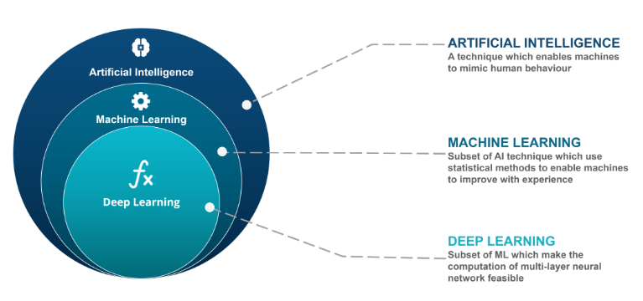

Slide 19
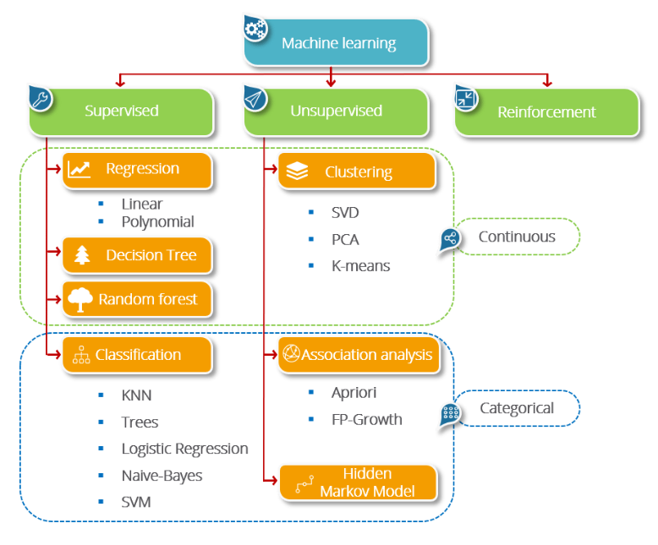
Machine Learning Types

Slide 20
Machine Learning allows the systems to make decisions autonomously without any external support. These decisions are made when the machine is able to learn from the data and understand the underlying patterns that are contained within it. Then, through pattern matching and further analysis, they return the outcome which can be a classification or a prediction.
Types of Machine Learning
Supervised Learning
Unsupervised Learning
Reinforcement Learning

Slide 21
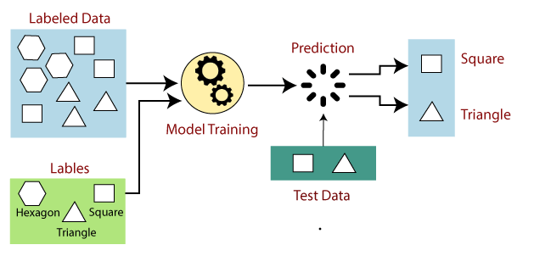
Supervised Learning
In supervised learning, models are trained using labeled dataset, where the model learns about each type of data. Once the training process is completed, the model is tested on the basis of test data (a subset of the training set), and then it predicts the output.

Slide 22
First Determine the type of training dataset
Collect/Gather the labeled training data.
Split the training dataset into training dataset, test dataset, and validation dataset.
Determine the input features of the training dataset, which should have enough knowledge so that the model can accurately predict the output.
Determine the suitable algorithm for the model, such as support vector machine, decision tree, etc.
Execute the algorithm on the training dataset. Sometimes we need validation sets as the control parameters, which are the subset of training datasets.
Evaluate the accuracy of the model by providing the test set. If the model predicts the correct output, which means our model is accurate.

Slide 23
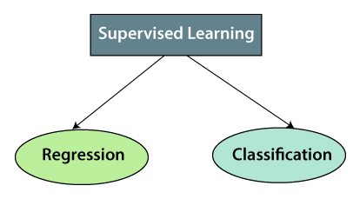
Supervised Learning can be further divided into two types of problems

Slide 24
Regression
Regression algorithms are used if there is a relationship between the input variable and the output variable.
It is used for the prediction of continuous variables, such as Weather forecasting, Market Trends, etc. Below are some popular
Regression algorithms which come under supervised learning:
Linear Regression
Regression Trees
Non-Linear Regression
Bayesian Linear Regression
Polynomial Regression

Slide 25
Classification
Classification algorithms are used when the output variable is categorical, which means there are two classes such as Yes-No, Male-Female, True-false, etc.
Spam Filtering,
Random Forest
Decision Trees
Logistic Regression
Support vector Machines

Slide 26
Advantages of Supervised learning:
With the help of supervised learning, the model can predict the output on the basis of prior experiences.
In supervised learning, we can have an exact idea about the classes of objects.
Supervised learning model helps us to solve various real-world problems such as fraud detection, spam filtering, etc.
Disadvantages of supervised learning:
Supervised learning models are not suitable for handling the complex tasks.
Supervised learning cannot predict the correct output if the test data is different from the training dataset.
Training required lots of computation times.
In supervised learning, we need enough knowledge about the classes of object.

Slide 27
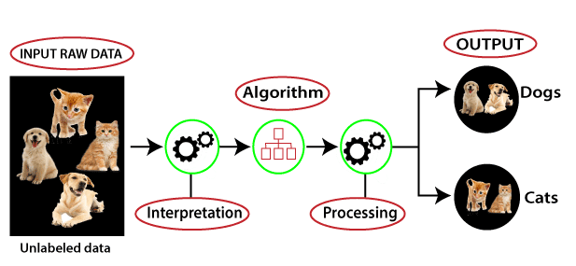
Unsupervised Learning
The model learns through observation and finds structures in the data. Once the model is given a dataset, it automatically finds patterns and relationships in the dataset by creating clusters in it. What it cannot do is add labels to the cluster, like it cannot say this a group of apples or mangoes, but it will separate all the apples from mangoes.

Slide 28
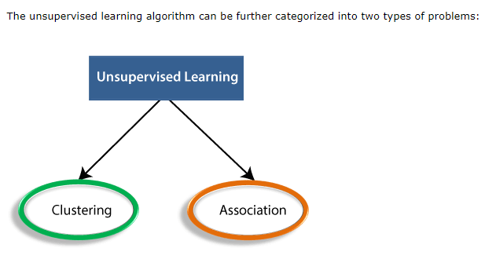

Slide 29
Clustering: Clustering is a method of grouping the objects into clusters such that objects with most similarities remains into a group and has less or no similarities with the objects of another group. Cluster analysis finds the commonalities between the data objects and categorizes them as per the presence and absence of those commonalities.
Association: An association rule is an unsupervised learning method which is used for finding the relationships between variables in the large database. It determines the set of items that occurs together in the dataset. Association rule makes marketing strategy more effective. Such as people who buy X item (suppose a bread) are also tend to purchase Y (Butter/Jam) item. A typical example of Association rule is Market Basket Analysis

Slide 30
Unsupervised Learning Algorithms
K-means clustering
KNN (k-nearest neighbors)
Hierarchal clustering
Anomaly detection
Neural Networks
Principle Component Analysis
Independent Component Analysis
Apriori algorithm
Singular value decomposition

Slide 31
Advantages of Unsupervised Learning
Unsupervised learning is used for more complex tasks as compared to supervised learning because, in unsupervised learning, we don't have labeled input data.
Unsupervised learning is preferable as it is easy to get unlabeled data in comparison to labeled data.
Disadvantages of Unsupervised Learning
Unsupervised learning is intrinsically more difficult than supervised learning as it does not have corresponding output.
The result of the unsupervised learning algorithm might be less accurate as input data is not labeled, and algorithms do not know the exact output in advance.

Slide 32
Supervised Learning | Unsupervised Learning
Supervised learning algorithms are trained using labeled data. | Unsupervised learning algorithms are trained using unlabeled data.
Supervised learning model takes direct feedback to check if it is predicting correct output or not. | Unsupervised learning model does not take any feedback.
Supervised learning model predicts the output. | Unsupervised learning model finds the hidden patterns in data.
In supervised learning, input data is provided to the model along with the output. | In unsupervised learning, only input data is provided to the model.
The goal of supervised learning is to train the model so that it can predict the output when it is given new data. | The goal of unsupervised learning is to find the hidden patterns and useful insights from the unknown dataset.
Supervised learning needs supervision to train the model. | Unsupervised learning does not need any supervision to train the model.
Supervised learning can be categorized in Classification and Regression problems. | Unsupervised Learning can be classified in Clustering and Associations problems.
Supervised learning can be used for those cases where we know the input as well as corresponding outputs. | Unsupervised learning can be used for those cases where we have only input data and no corresponding output data.
Supervised learning model produces an accurate result. | Unsupervised learning model may give less accurate result as compared to supervised learning.
Supervised learning is not close to true Artificial intelligence as in this, we first train the model for each data, and then only it can predict the correct output. | Unsupervised learning is more close to the true Artificial Intelligence as it learns similarly as a child learns daily routine things by his experiences.
It includes various algorithms such as Linear Regression, Logistic Regression, Support Vector Machine, Multi-class Classification, Decision tree, Bayesian Logic, etc. | It includes various algorithms such as Clustering, KNN, and Apriori algorithm.

Slide 33
What is Algorithm ?
An algorithm is a step by step procedure to solve a problem in computer world

Slide 34
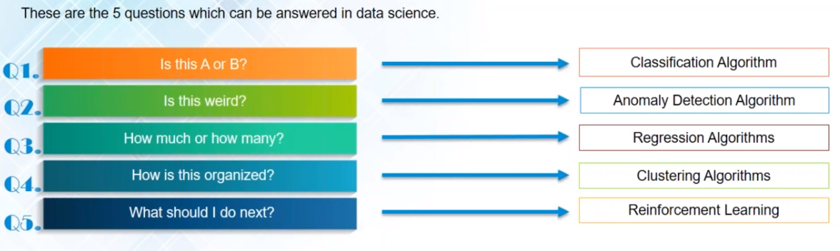
How Problem is solved using ML ?

Slide 35
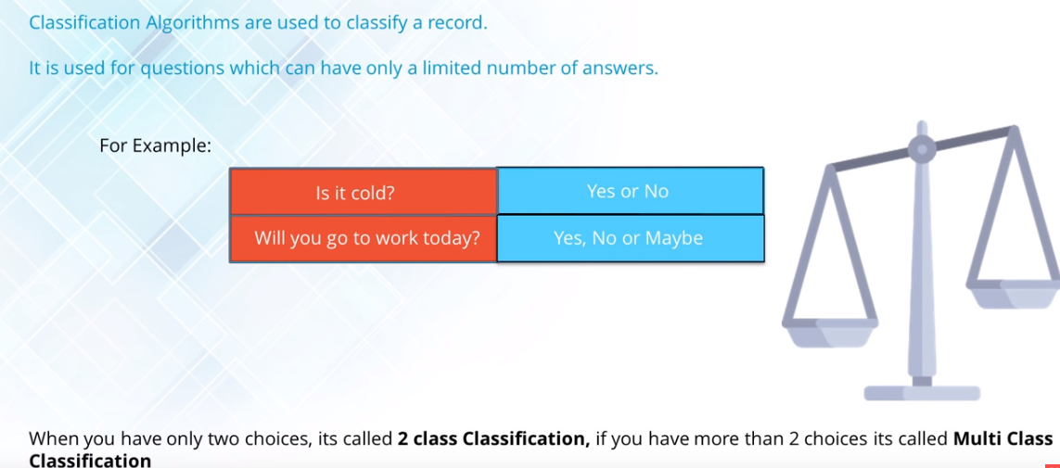
Classification

Slide 36
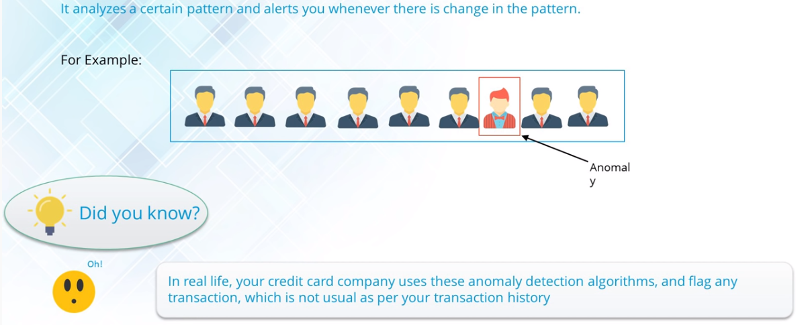
Anomaly Detection

Slide 37
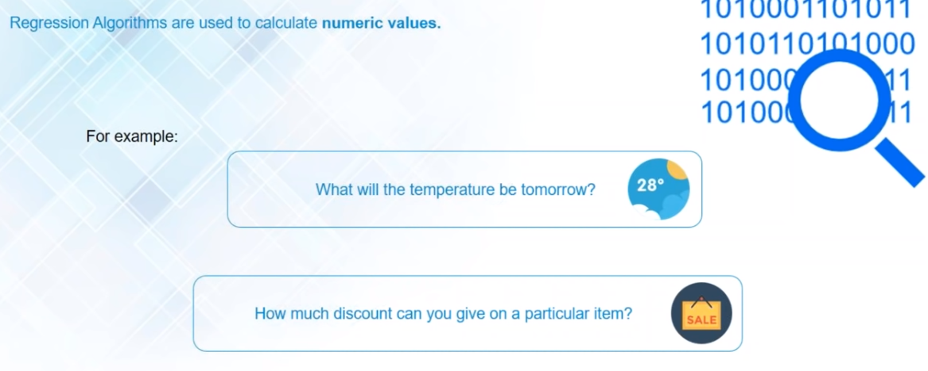
Regression

Slide 38
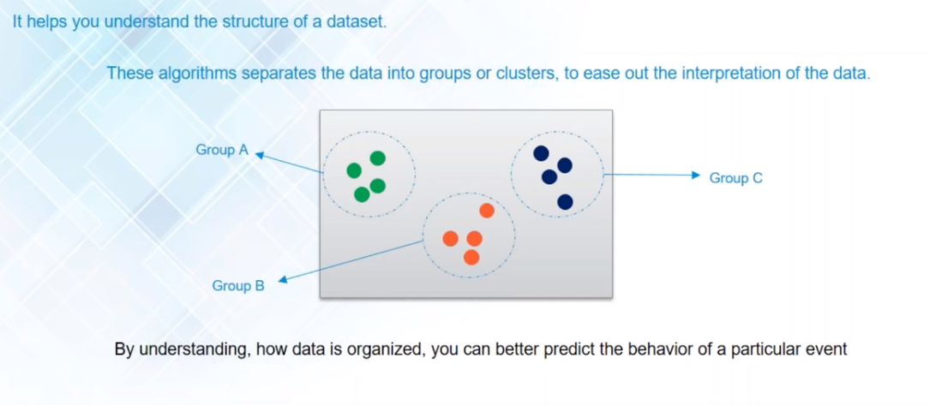
Clustering

Slide 39
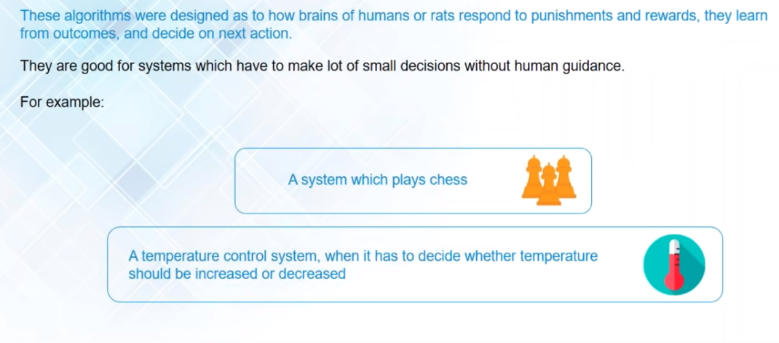
Reinforcement

Slide 40
Regression
Regression Analysis is a form of predictive modeling technique which investigates the relationship between dependent & independent variable
Uses of Regression Analysis
Determine the strength of predictors
Forecasting an effect
Trend Forecasting

Slide 41
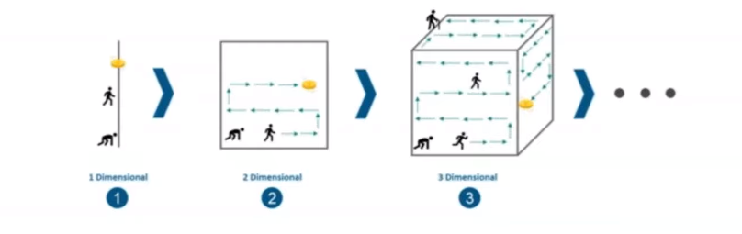
PCA [ Principle Component Analysis ]
High dimensional data is extremely complex to process due to inconsistencies in the features which increase the computation time and make data processing and EDA more convoluted

Slide 42
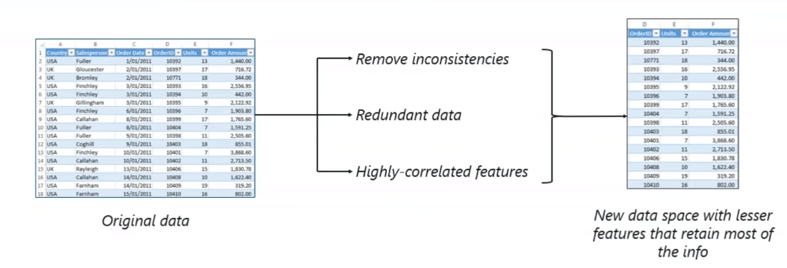
Principle Component Analysis [ PCA ] is a dimensionality reduction technique that enables you to identify correlations and patterns in a data set so that it can be transformed into a data set of slightly lower dimension without loss of any important information

Slide 43
PCA Steps
Standardization of the data
Computing the Covariance Matrix
Calculating the eigenvectors & eigenvalues
Computing the principle components
Reducing the dimensions of data

Slide 44
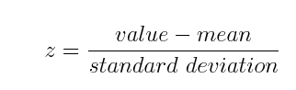
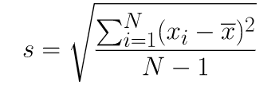
Step 1 : Standardization of Data
Standardization is all about scaling your data in such a way that all the variables and their values lie within a similar range
Standard Deviation Formula

Slide 45
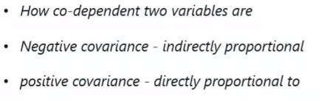
Step 2 : Computing Covariance Matrix
Covariance is a measure of the extent to which corresponding elements from two sets of ordered data move in the same direction.
We use the following formula to compute covariance.
Cov(X, Y) = Σ ( X_{i} - X ) ( Y_{i} - Y ) / N = Σ x_{i}y_{i} / N
N is the number of scores in each set of data X is the mean of the N scores in the first data set X_{i} is the ithe raw score in the first set of scores x_{i} is the ith deviation score in the first set of scores Y is the mean of the N scores in the second data set Y_{i} is the ithe raw score in the second set of scores y_{i} is the ith deviation score in the second set of scores Cov(X, Y) is the covariance of corresponding scores in the two sets of data
Covariance value denotes

Slide 46
Step 2 : Computing Covariance Matrix
Covariance Matrix is a measure of how much two random variables gets change together. It is actually used for computing the covariance in between every column of data matrix.
The aim of this step is to understand how the variables of the input data set are varying from the mean with respect to each other, or in other words, to see if there is any relationship between them. Because sometimes, variables are highly correlated in such a way that they contain redundant information. So, in order to identify these correlations, we compute the covariance matrix.

Slide 47
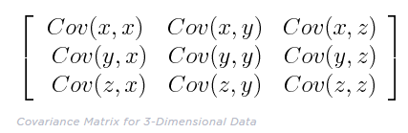
The covariance matrix is a p × p symmetric matrix (where p is the number of dimensions) that has as entries the covariance's associated with all possible pairs of the initial variables. For example, for a 3-dimensional data set with 3 variables x, y, and z, the covariance matrix is a 3×3 matrix of this from:

